Slide 1

M2M Tech Connect - Data Talent Program
Capstone 1 – Cohort 17
Javad Hooshmand
August 2025

Slide 2






Project Overview
Relationship between global air quality (PM2.5 concentration), and climate variables: temperature, precipitation, and humidity.
Interactive dashboard for global air quality trend from 1990 to 2020.
Tools:

Slide 3
Project Steps
1
Data Preparation
2
Data integrated from World Bank
Transformation
Standardized
Checked missing values
Merged data
EDA
Distribution Analysis
Central Tendency Measures
Time-Series Trends
Bivariate Analysis
3
Visualization
Heatmap Correlations
Global Air Quality Analysis Dashboard

Slide 4
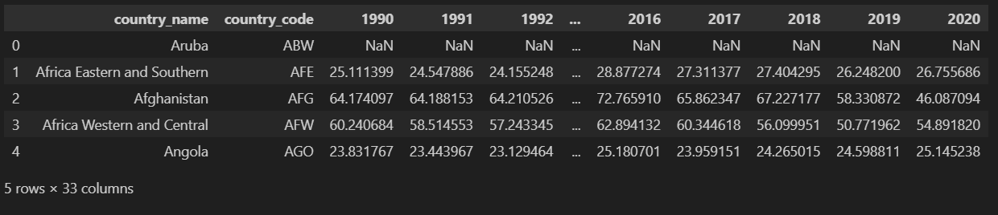
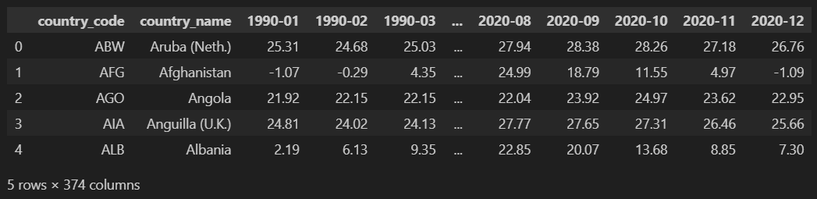
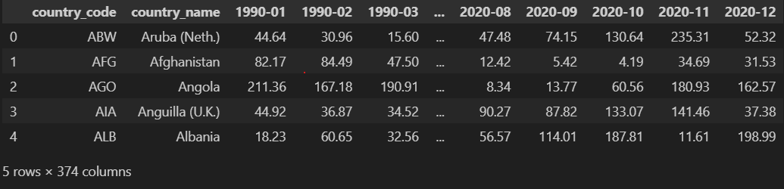

Dataset Integration
PM2.5 Concentration
Annual mean concentration (µg/m³) of fine particulate matter by country.
Air Temperature
Country-level average temperature
(°C) per month.
Precipitation
Total monthly precipitation (mm) per
country.
Relative Humidity
Monthly average humidity (%) per
country.

Slide 5
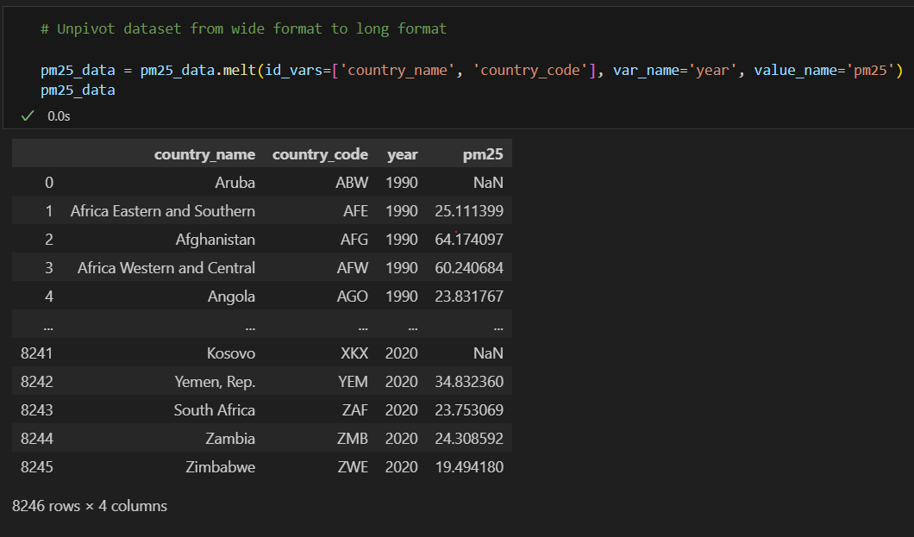


Data Transformation Pipeline
01
02
Format Conversion
Data Type Alignment
Converted datasets from wide to long format for consistent year-based alignment.
Ensured year columns were integer types for proper time-series handling.
03
Missing Value Removal
Removed missing PM2.5 values

Slide 6
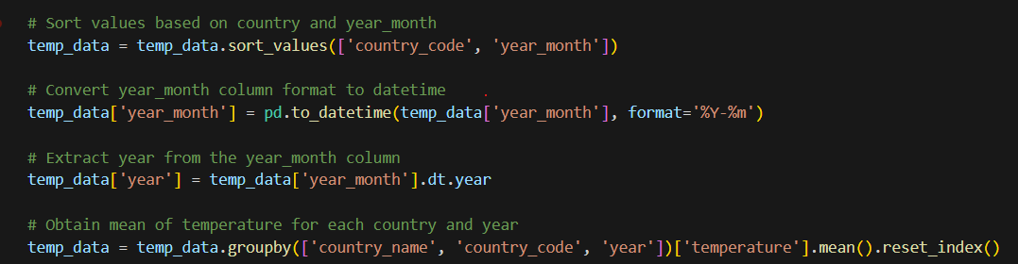
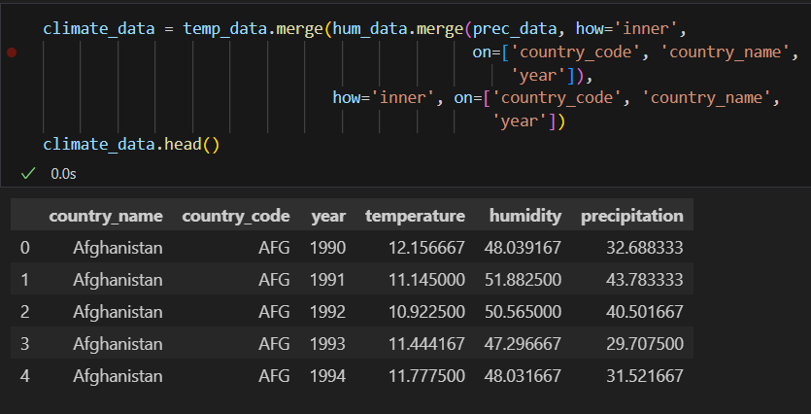
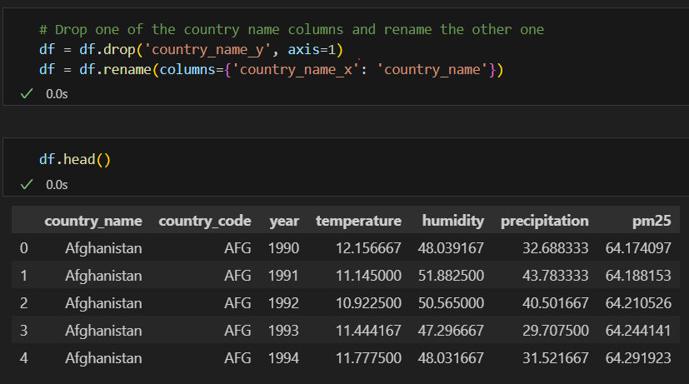
Data Transformation Pipeline (Cont…)
04
Climate Data Standardization
Sorted, formatted dates, extracted years, and calculated annual averages.
05
Unified Dataset Merge
Merged climate variables with PM2.5 data using country and year as primary keys.

Slide 7
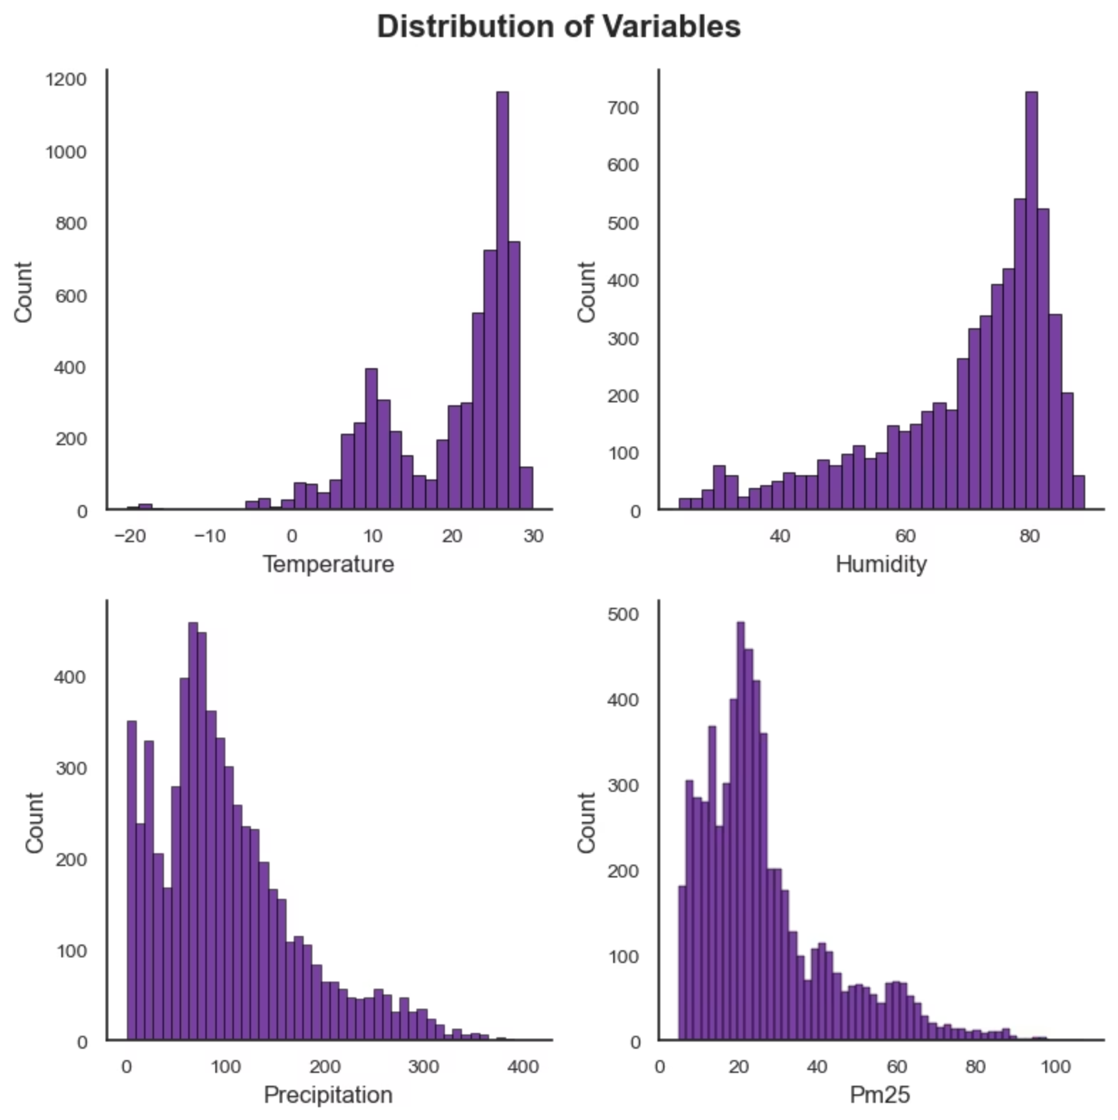

Exploratory Data Analysis (EDA)
Distribution

Slide 8
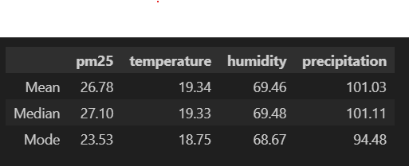
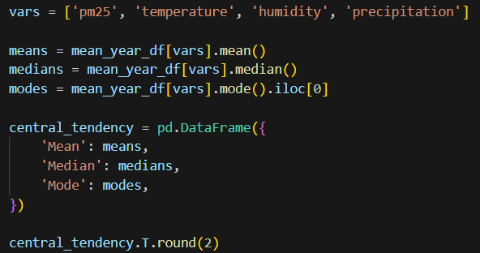
Exploratory Data Analysis (EDA) (Cont…)
Central Tendency

Slide 9
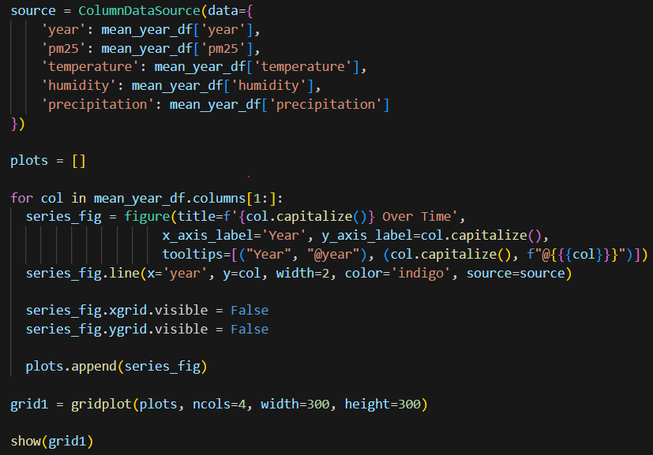
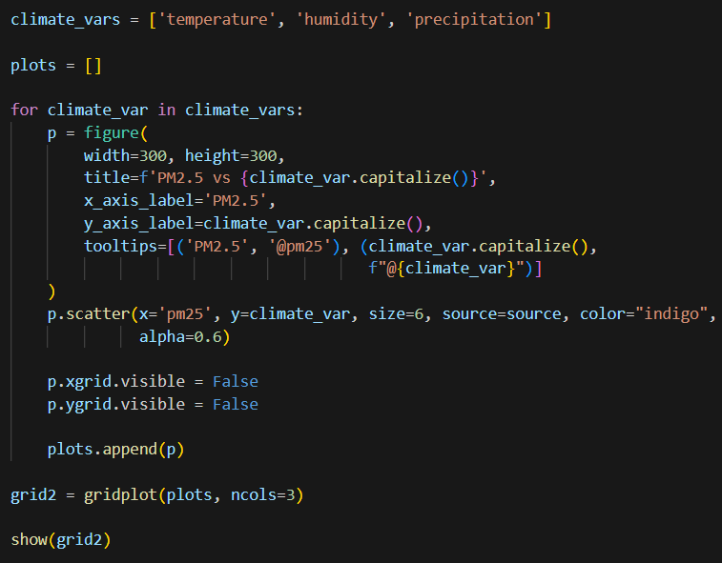
Exploratory Data Analysis (EDA) (Cont…)
Time-Series Trends
Bivariate Analysis

Slide 10
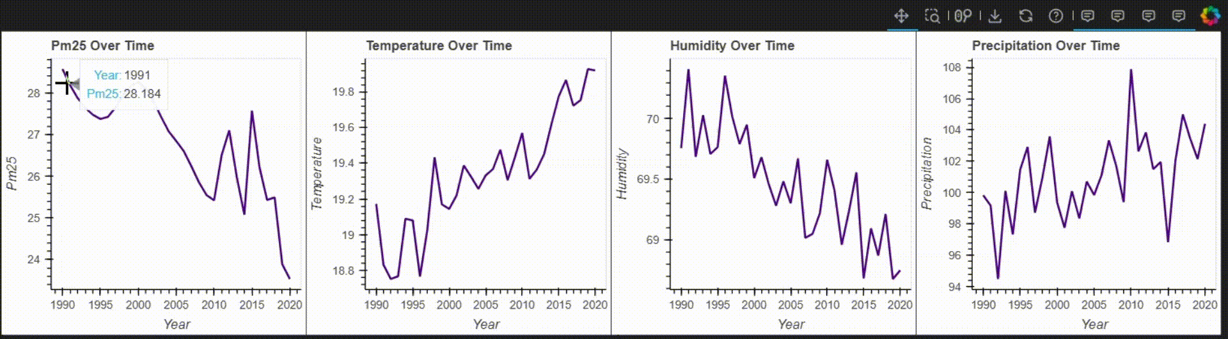
Exploratory Data Analysis (EDA) (Cont…)
Time-Series Trends

Slide 11
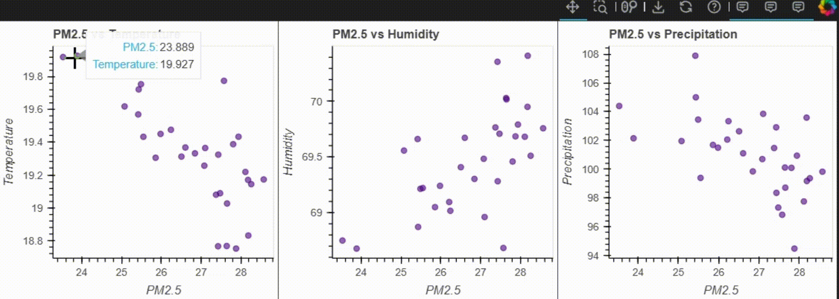
Exploratory Data Analysis (EDA) (Cont…)
Bivariate Analysis

Slide 12
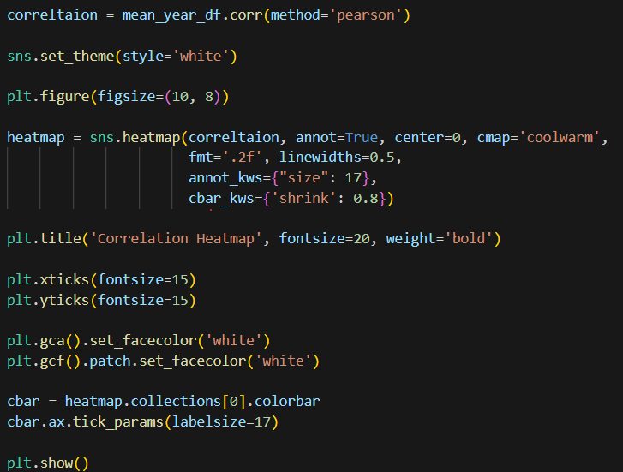
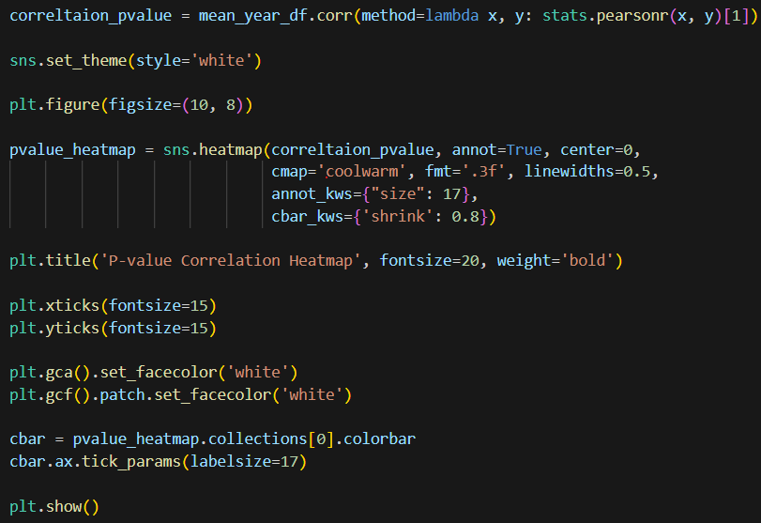
Visualizations & Dashboard
Heatmap
P-value map

Slide 13
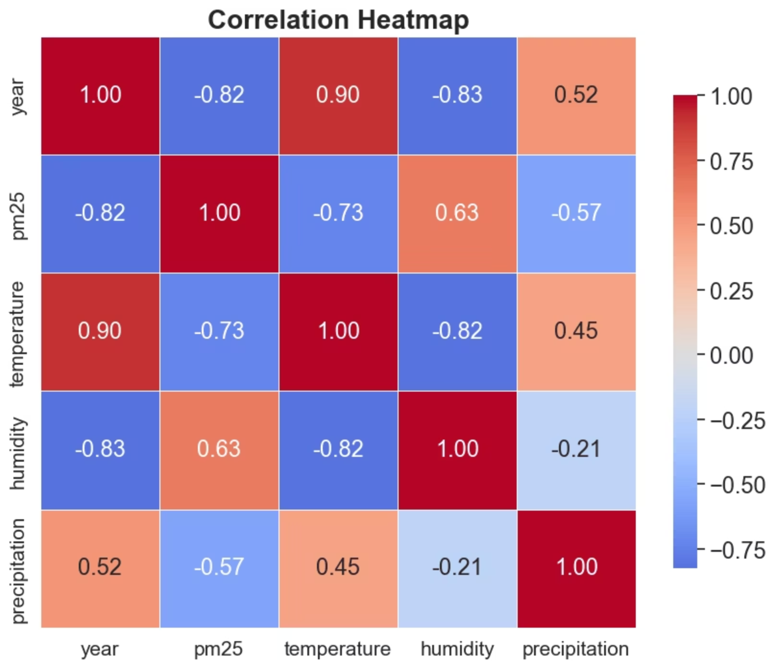
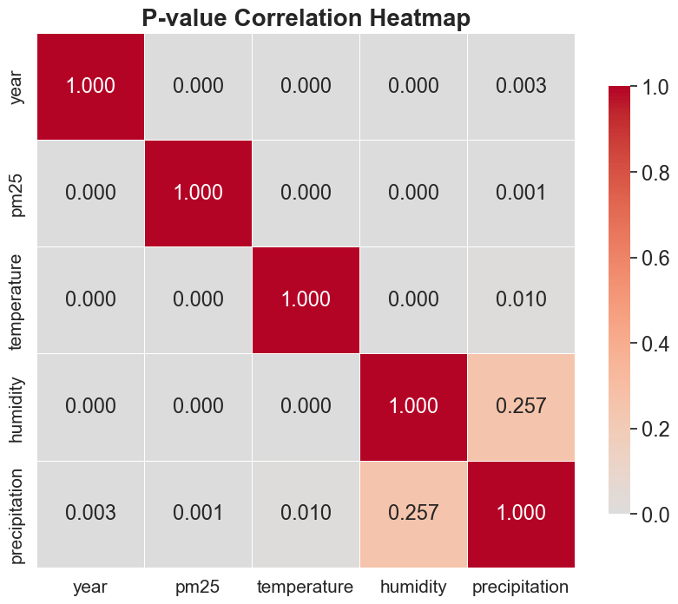
Visualizations & Dashboard
Heatmap
P-value map

Slide 14
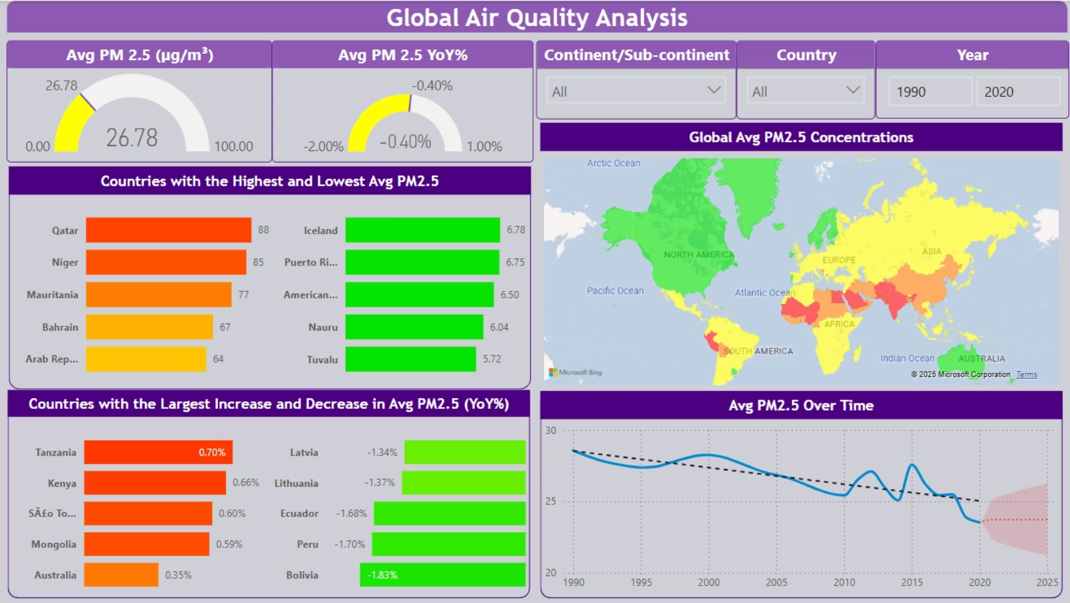
Visualizations & Dashboard
Global Air Quality Dashboard

Slide 15


Key Insights: Climate's Influence on Air Quality
Temperature Relationship
Precipitation Impact
Humidity Effect
Higher temperatures were associated with depressed PM2.5 levels.
Higher rainfall correlated with lower PM2.5, likely due to particulate washout.
In humid climates, PM2.5 levels showed a modest correlation.

Slide 16
Key Insights: Regional Disparities & Trajectories
1
2
Global PM2.5 Decline
Varied Regional Impact
Developed countries showed gradual improvement, while some developing nations experienced rising PM2.5 levels.
Northern Africa, South, and East Asia displayed the highest PM2.5 concentrations.
3
4
Africa's Improvement Lag
Oceania's Worsening Trend
Africa showed the least improvement in average PM2.5 YoY%, contrasting with Europe's best improvement.
Oceania is the only region with below-average PM2.5 whose air quality is deteriorating over time.

Slide 17






Thank You!
Contact:
Javad.hooshmand@outlook.com

